Slide 1
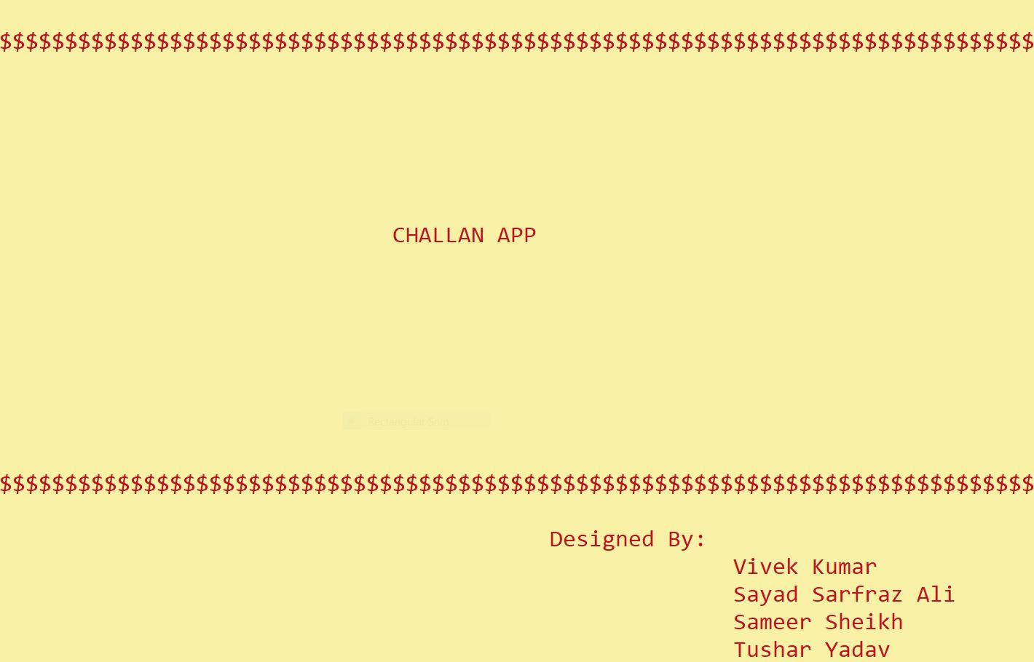

Slide 2
Introduction
This project work is a part of Object Oriented programming in C++, Submitted To the Department of Computer Science Engineering.
As The name suggests, Over Project is basically a E-CHALLAN application that facilitates the Traffic Police Authorities to generate Traffic CHALLAN And the Citizen to see there CHALLAN details.
A CHALLAN Numbers Generates (Automatically) then Some details entered (Manually) and Violations selected(Manually) And A CHALLAN FORM Displayed and Saved (in TEXT file).

Slide 3
Objectives
To became familiar with the basic concepts of OOP such as objects, classes, Functions , loops etc and implementation of the OOP approach through C++.
To take the input through keyboard.
To Help our Most Honorable Traffic Police Authorities.
To practice teamwork and develop the interactive level between teachers and students.
To Increase Interest of students towards coding C++ AND OPPS.

Slide 4
Application
This is an application which we suppose will be liked by its user. Some of the applications of our project are listed as below
This project has been developed as a tool to increase our interest and knowledge in the field of OPPS AND C++ Programming.
This project has been designed to Save time of Traffic Police Authorities AND the Citizen as well.
This application can be used as THE TRAFFIC POLIC CHALLAN APPLICATION with further improvements.
We also have Some ideas to add TOLL BOOTH and POLICE STATION features in this APPLICATIONS . Which We sure a pretty cool Idea

Slide 5
Concept Used:-
1. Object-Oriented programming
2. Sleep() Function
3. Gotoxy Function
4. System(“color”)
5. Getch() Function
6. Vector
7. Time & Date
8. rand() and srand() Function
9. File Stream

Slide 6
1. Object-Oriented programming
In our Project the main aim of OOP is to bind together the data and the functions that operate on them so that no other part of the code can access this data except that function.

Slide 7
2. Sleep Function
The sleep () function causes the program or the process in which it suspend its execution of program temporarily for a period of time in seconds specified by the function parameter. Using Sleep() function we must have to include a header file i.e. #include<windows.h>
Sleep(1000) // 1000 = 1sec | Sleep(400) // 0.4 sec
Ex:-
cout<<"Loading";
Sleep(400);
cout<<".";
Sleep(400);
cout<<".";
Sleep(400);
cout<<".";
Sleep(400);

Slide 8
3. Gotoxy Function
The gotoxy function is used to to move the cursor to a specified location on the screen. It moves the cursor with respect to x axis and y axis. The Variable x indicates x-axis. Its Value can be from 0 to 79. The Variable y indicates the y-axis. Its Value can be from 0 to 24.
gotoxy() is a standard C function defined in <conio.h>, but it will not work in ANSI C compilers such as Dev-C++. Because gotoxy() is a Turbo-C++ specific function, which means it is not part of the standard. However, if you insist on using console functions, you can define your own function by using member functions available in <windows.h>
COORD coord = {0, 0};
void gotoxy (int x, int y) //defining/initializing to predefined objects
{
coord.X = x;
coord.Y = y; // X and Y coordinates
SetConsoleCursorPosition(GetStdHandle(STD_OUTPUT_HANDLE), coord);
}

Slide 9
4. System(“color”)
In C++ programming, the background of the output screen is black and text color is in white color. We can color both the background and text color in the output screen in the following ways.
Header File -> #include<windows.h> || #include<stdlib.h>
Syntex -> system(“color E4”)
E = background color
4 = text color
COLOR ID | COLOR | COLOR ID | COLOR
1 | Blue | 9 | Light Blue
2 | Green | 0 | Black
3 | Aqua | A | Light Green
4 | Red | B | Light Aqua
5 | Purple | C | Light Red
6 | Yellow | D | Light Purple
7 | White | E | Light Yellow
8 | Gray | F | Bright White

Slide 10
5. Getch Function
The getch() function reads a single character from the keyboard but does not show on the screen. For this functionality, you can use the getch() function to hold the output window until hitting any key from the keyboard.
The getch() method can be used to accept hidden inputs like password, ATM pin numbers, etc.
Header File -> #include<conio.h>

Slide 11
6. Vector
Vector is a inbuilt data structure same as the dynamic array which is use to store data in a contiguous memory
It has ability to resize itself automatically when an element is inserted or deleted, with their storage being handled automatically by the container.
It is made up of templates
Header File -> #include<vector>
Syntex -> vector<int>v
In our project we use two functions of vector i.e.
1. push_back()
2. clear()

Slide 12
7. Time & Date
Header File -> #include<ctime>
time() = The time() function in c++ returns the current calendar time as an object of type time_t.
Localtime() = The localtime() function converts calendar times to localtime.
Struct tm = The tm is inbuilt with structure that hold a calendar date and timesome components of struct tm -> tm_sec, tm_min, tm_hours etc.
Strftime() = It is used to formate date and time according to formatting rulesin format and store it in character array s.
Syntex of strftime() = strftime(char *s,sizeof(s), “formates", struct tm *c);
Some formats of strftime
1. %a = Abbreviated weekday name
2. %b = Abbreviated month name
3. %d = Day of the month etc.

Slide 13
time_t rawtime; tm * timeinfo; char buffer[80]; time (&rawtime); timeinfo = localtime(&rawtime); strftime(buffer,sizeof(buffer),"%a %d-%b-%Y %H:%M:%S",timeinfo); cout<<buffer;
Inbuilt data in ctime header file
Object of time_t
Object of inbuilt struct tm
This fun match current date and time with your device and assign to tm object
Time fun which take a address of time_t type of object
Formates of strftime fun

Slide 14
8. rand() and srand() Function
rand() function is used in C++ to generate random numbers it will create the same sequence again and again every time program runs.
srand() function in C++ It take argument as time().which continuously changes number after every compile.
int random()
{
srand( time(0));
int rN;
rN = (rand() % 99999)+10000;
return rN;
}
It generate random no. which is any no. 0 to 99999.
We add 10000 because we need 5-digit random no.

Slide 15
9. File Stream
Header File = #include<fstream>
Ofstream = Creates and writes to files
Syntex = ofstream ifile; // ifile is an object
ifile.open(filename); // open fun is open a file
ifile<<data; // what we have stored in data that will save in filename
Ifstream = Reads from files
Syntex = ifstream ifile;
while(! ifile.eof()){ // eof() fun say where text end in file
string s;
ifile>>s;
cout<<s; }
Fstream = A combination of ofstream and ifstream: creates, reads, and writes to files

Slide 16
Functions
void wel(); // welcome screen
void first(); // 1st page of program after welcome
void citizen(); // It shows offenders challan details
void frame(); // It shows upper and lower border with some animation
void frame_fix(); // It shows upper and lower border without animation
void login(); // Login section for admin which ask for password
void load(); // It shows loading screen
void main_menu(); // Main Menu section
void details(); // In this section we fill offenders details
void calculator(); // In this we calculate challan if violation more then one
void form(); // Final form of reciept
int random(); // It generate random number
string date(); // It shows actual date which the offenders breaks the rule
string times(); // It shows actual time which the offenders breaks the rule
void time_date(); // It shows time and date in upper border of a frame
void note(); // Our Exit page

